Slide 1
CSE5095-002: Topics in Software Defined Networking
Lecture 1
Minmei Wang
Computer Science and Engineering
Slides source: Kurose and Ross, Chen Qian

Slide 2
Welcome to CSE 5095-002!
Topics in Software Defined Networking
Class information:
When: Tu Th 9:30am-10:45am.
Where: MCHU 107.
Class Web page:
HuskyCT

Slide 3
About the Instructor
Minmei Wang.
Office: ITE 257.
E-mail: minmei.wang@uconn.edu
Office hours: Wednesday, 11am-12pm

Slide 4
Pre-Requisites
CSE 3300 or undergrad level networking course.

Slide 5
Books
Lecture:
Computer Networking: A Top Down Approach,
by Kurose and Ross
5th, 6th, 7th and 8th ed are all good

Slide 6
Course Outline
Basic Knowledge of computer networking
Network layer
Topics related to the road towards SDN
Separation of control and data planes
OpenFlow and Mininet
SDN controllers
Network virtualization
Programmable data planes
Middleboxes, and NFV
Recent research work for programmable data planes

Slide 7
Lectures
The more interactivity, the better!
Ask questions!
Actively participated in discussions
Or answer my questions.
Lecture notes:
Will be posted on-line before class.
Final version will be posted after class.

Slide 8
Resources
Instructor.
Class Web page.
Lecture notes will be posted before class.
Office hours
Wednesday 11:00 am – 12: 00 pm

Slide 9
Grading Rubric
Reading reports 15%
In-class presentation 25%
Midterm 25%
Course project 35%

Slide 10
Reading reports
You should submit no fewer than 10 reading reports
I will set the deadline for the report of each paper later
Each report will be graded as a check- (0.5pt), check (1pt), or check+ (1.5pt).
You may submit more but we only count the 10 reports with highest grades.

Slide 11
Midterm
Midterm will be on 10/18/2022

Slide 12
In-class presentation
Submit your preference of 8 papers by 09/20/2022, sent by email to minmei.wang@uconn.edu
Subject: CSE5095-002 paper presentation preference of [your first name] [middle name] [last name] (e.g., Minmei Wang)
From the highest priority to the lowest priority
Each presentation I will assign a challenger who is expected to ask questions related to the paper

Slide 13
Project
Course Project
a survey describing a sub-area of SDN (related to at least two papers)
a research work including a novel idea and algorithm/system design related to the survey topic.
(A desired option) an implementation of your idea and comparison with existing work
Individual or a group with two students
20% bonus for the desired option
Submit your proposal for the project by 10/21/2022
Just one page to illustrate your main idea and plans

Slide 14
Student Responsibilities: Academic Integrity
All submitted work must be individual.
OK to have discussions on ideas but turn in your own work.
Ask instructor if there are any questions.
For more info, go to:
https://ugradresearch.uconn.edu/academic-integrity/
Academic integrity violations will not be tolerated.

Slide 15
Accommodations
Please talk to me in person or email
Talk to me about your needs SOON!
Center for Students with Disabilities

Slide 16
Student Responsibilities
Attendance.
Lectures.
Keep up with material covered in lecture
Readings (chapters in the book or papers).
Keep up with reading assignments and project.
Turn in the assignments on time!

Slide 17
Student Feedback
Feedback is always welcome!
Chance to do it at the end of the quarter.
But you can also do it during the quarter…

Slide 18
Assignment late submission policy
20% deduction for each day late.
Don’t be late

Slide 19
Administrative Info
Communication:
E-mail preferred.
Send e-mail to instructor.

Slide 20
My Research
Networks, Systems, and Security
Current focus: Internet of Things (IoT), Software Defined Networking (SDN), Network Security, and Data Analysis for Mobile Networks

Slide 21

Time for you to introduce yourself!

Slide 22
Review of important networking concepts

Slide 23
Networks: overview
1.1 Terms of a network
1.2 network edge
end systems, access networks, links
1.3 network core
packet switching, circuit switching, network structure
1.4 protocol layers
Notes:
23

Slide 24

What are the components of a computer (communication) network?
Links, nodes, and
Terminals/hosts/end systems/servers
What’s the difference between “nodes” and “hosts”?

Slide 25
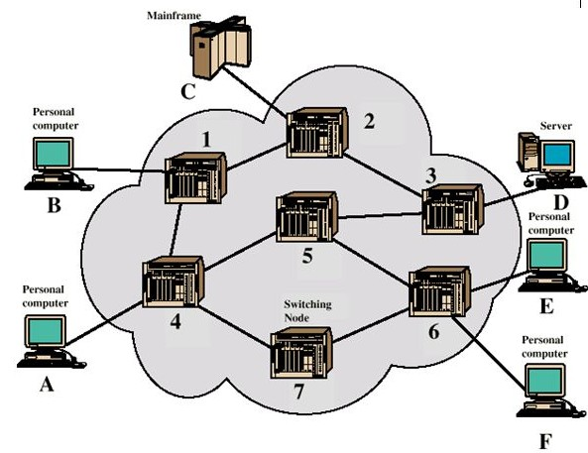
Nodes and hosts
Source: K. Salah Module 3.4
A host is a node that participates in user applications, either as a server, client, or both.

Slide 26






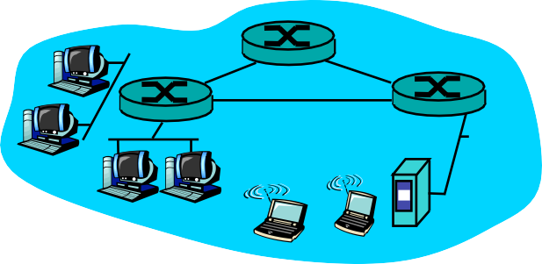

What’s the Internet: “Nuts and Bolts” View
Internet: “network of networks”
hierarchical
Mobile network
Global ISP
Home network
Regional ISP
Institutional network

Slide 27
What’s the Internet: “Service” View
Communication Infrastructure
enables distributed applications:
Web, VoIP, email, games, e-commerce, file sharing
Communication services provided to apps:
reliable data delivery from source to destination
“best effort” (unreliable) data delivery
Mobile network
Global ISP
Home network
Regional ISP
Institutional network

Slide 28
What are the performance metrics we care about?
Latency
Bandwidth/throughput
Bandwidth: the max throughput a communication link can provide
Scalability
When size is large, will there be a problem?
Reliability
When some nodes/hosts fail
Security
Financial cost

Slide 29

















A closer look at network structure:
network edge:
hosts: clients and servers
servers often in data centers
mobile network
global ISP
home
network
access networks, physical media: wired, wireless communication links
regional ISP
network core:
interconnected routers
network of networks
institutional
network

Slide 30









The network core
packet-switching: hosts break application-layer messages into packets
forward packets from one router to the next, across links on path from source to destination
each packet transmitted at full link capacity

Slide 31

Packet Switching: queueing delay, loss
R = 100 Mb/s
C
A
D
R = 1.5 Mb/s
B
E
queue of packets
waiting for output link
queuing and loss:
If arrival rate (in bits) to link exceeds transmission rate of link for a period of time:
packets will queue, wait to be transmitted on link
packets can be dropped (lost) if memory (buffer) fills up

Slide 32
Alternative core: circuit switching
end-end resources allocated to, reserved for “call” between source & dest:
dedicated resources: no sharing
circuit-like (guaranteed) performance
circuit segment idle if not used by call (no sharing)
Commonly used in traditional telephone networks

Slide 33
Packet switching versus circuit switching
packet switching allows more users to use network!
example:
1 Mb/s link
each user:
100 kb/s when “active”
active 10% of time
circuit-switching:
10 users
packet switching:
with 35 users, probability > 10 active at same time is less than .0004 *
N
users
…..
1 Mbps link
Q: how did we get value 0.0004?
$$P\left(X=n\right)=C_{35}^{n}∙{0.1}^{n}∙{0.9}^{(35−n)}$$

Slide 34
Packet switching versus circuit switching
is packet switching a “slam dunk winner?”
great for bursty data
resource sharing
simpler, no call setup
excessive congestion possible: packet delay and loss
protocols needed for reliable data transfer, congestion control
Q: human analogies of reserved resources (circuit switching) versus on-demand allocation (packet-switching)?

Slide 35
Internet protocol stack
application: supporting network applications
FTP, SMTP, HTTP
transport: process-process data transfer
TCP, UDP
network: routing of datagrams from source to destination
IP, routing protocols
link: data transfer between neighboring network elements
Ethernet, 802.111 (WiFi), PPP
physical: bits “on the wire”
application
transport
network
link
physical

Slide 36
Encapsulation
source
message
M
application
transport
network
link
physical
segment
H_{t}
M
H_{t}
datagram
H_{n}
H_{n}
H_{t}
M
frame
H_{l}
H_{n}
H_{t}
M
link
physical
switch
destination
H_{n}
H_{t}
M
network
link
physical
M
application
transport
network
link
physical
H_{l}
H_{n}
H_{t}
M
H_{n}
H_{t}
M
H_{t}
M
H_{n}
H_{t}
M
H_{l}
H_{n}
H_{t}
M
router

Slide 37
Next Lecture
Network Layer: Control planes and data planes

